Slide 1
Project Title: DIY 8K Inspection of Instrument Air Compressor
Business Case/objectives:
The 8,000hr inspection and servicing of the Okoloma Gas Plant's Atlas Copco Air Compressors is usually carried out by a vendor which costs circa $5,000 to execute for 1 compressor. This Initiative is for the in-house execution of inspection and servicing of K6807 using in-house resources and project surplus materials to save the $5,000.
Potential Benefits & Measurement:
circa $ 5,000
Project Scope/Actions :
Assemble all the required parts
obtain asset approval
Execute 8K Inspection
Critical Success Factors:
Okoloma/IMOR PU leadership support
High-level Timeline:
L0-L1: October2018
L2: October2018
L3: October 2018
L4: October2018
L5: October2018
Initiative End
Project Sponsor: Onyeka Ikechukwu Implementation Lead: Ogbodu Rume
Project Team:
Edwin Nwaugo
Evans Peters
Darlington Nwankwo

Slide 2
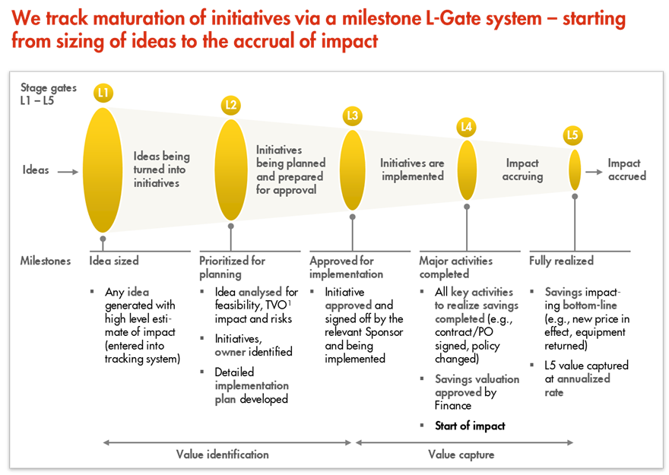
L1 – L5 Gates

